Slide 1



Advanced Topics Lesson
Presentation
Student Performance Data Set
Nuriye Merve Tatlıdil
150212002

Slide 2
Timeline
Data Set Information
Data Types Information
Algorithms
Evaluation
01
01
03
04
05
Data Preprocessing Step
Algorithm results.

Slide 3

Data Set Information
-This data approach student achievement in secondary education of two Portuguese schools. The data attributes include student grades, demographic, social and school related features.
-Data set has 395 Instances, 33 attributes.There
are 30 social qualities in 33 attributes. The other
2 qualities are midterm points and the final score
is the final grade.
-MY GOAL: To determine the letter grade
according to the final grade.
15-20 : A
10-15 : B
5-10 :C
0- 5 :D

Slide 4

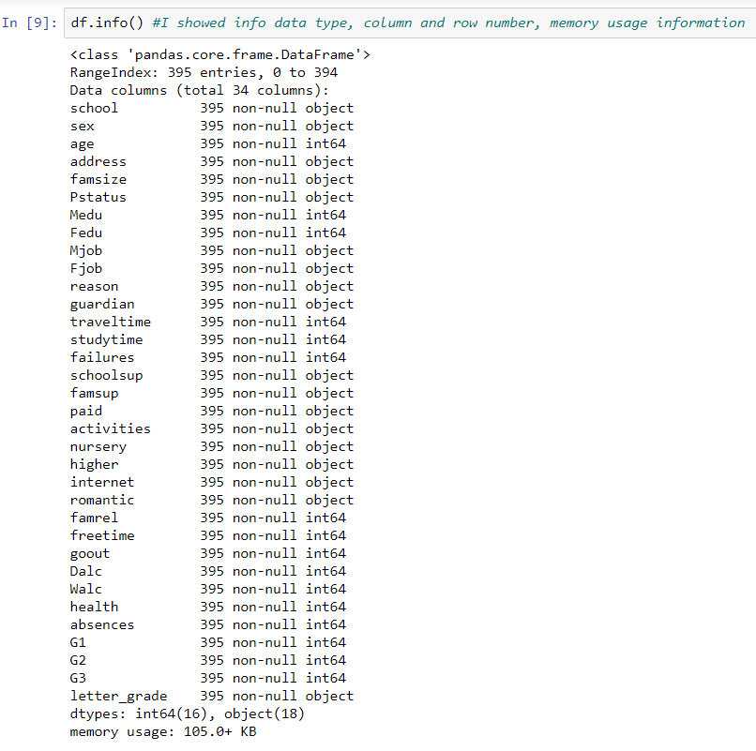
Data Types Information
I Deleted

Slide 5
Pre Processing Step
01
02
03
04
05
I checked for missing value. I did not take action because it is not
I showed how I can trade when there is an outlier value
I applied One-Hot transform to attributes
with more than 2 variables
I applied 0-1 transformation to attributes containing 2 variables
I converted the final grades to letter_grade

Slide 6

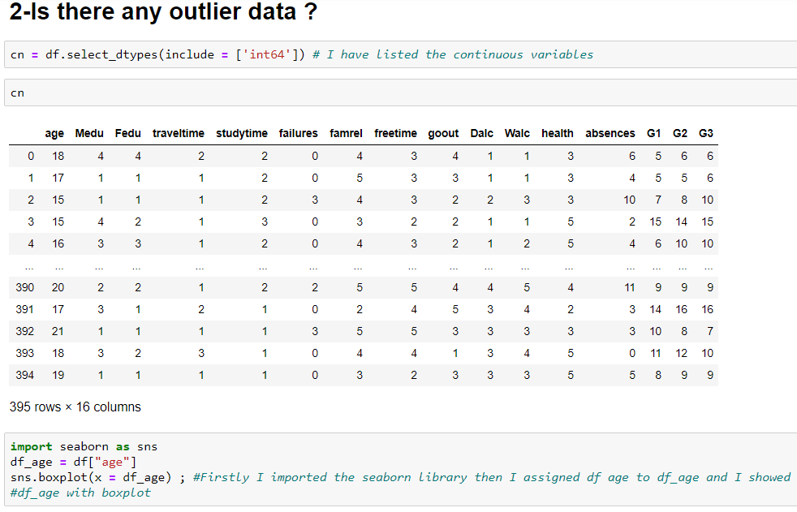
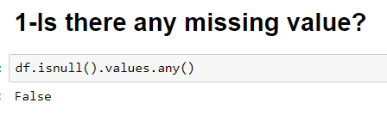
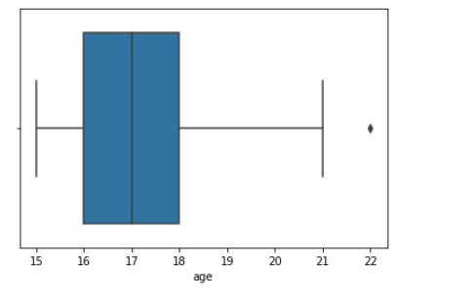
DATA CLEANING
outlier
data

Slide 7

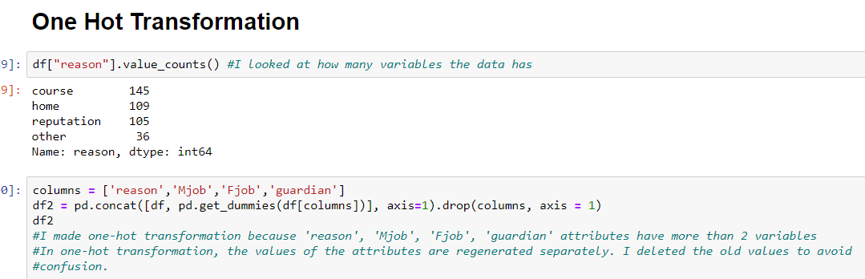
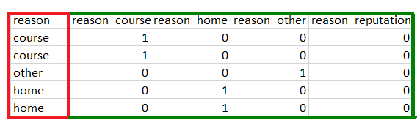
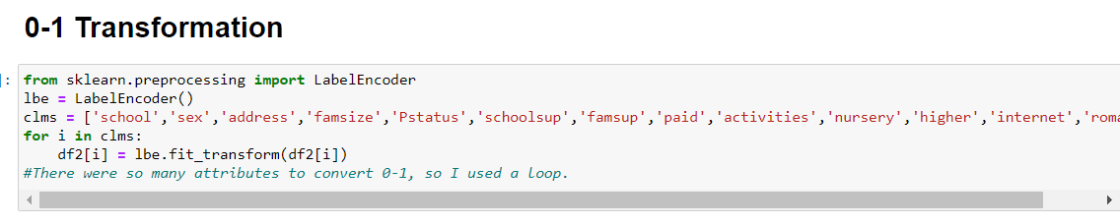
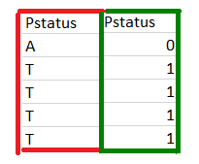
DATA TRANSFORMATION
FIRST LAST
FIRST LAST

Slide 8

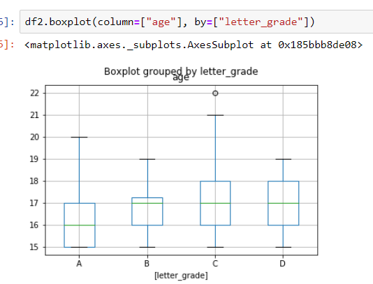
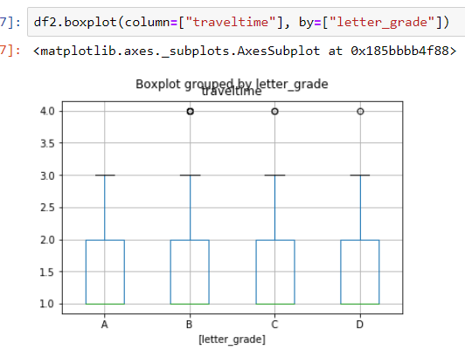
BOX PLOT
age – letter_grade
traveltime_letter_grade

Slide 9

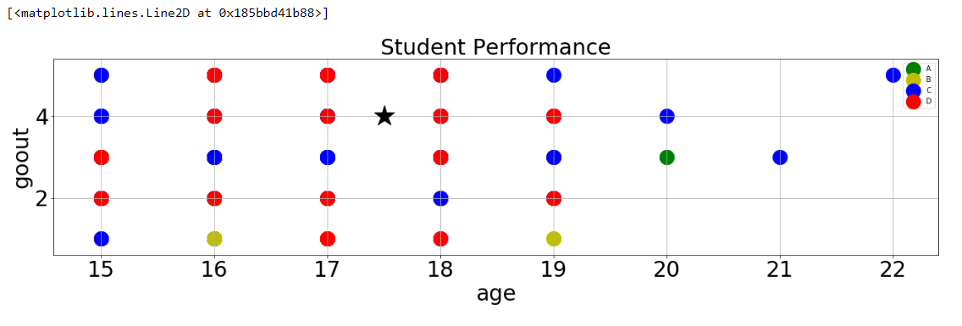
SCATTER PLOT
Red

Slide 10


ALGORITHMS
K Nearest Neighborhood
Algorithm

Slide 11

Algorithm
KNN
Without With
Standard Standard
Scaler Scaler
k=3,5,7,9 k=3

Slide 12

Evaluation
Algorithm | Accuracy
1 k = 3 %79
2 k = 5 %88
3 k = 7 %88
4 k = 9 %89
5 k = 3 (S.S) %51

